Slide 1

Sixth Edition
Chapter 10
The Nonexperimental and Quasi-Experimental Strategies

Slide 2
Review of Research Design Terminology
IVs within the context of nonexperimental and quasi-experimental research:
  Independent variable (IV): the variable that is used to differentiate the groups of participants or the groups of scores being compared
    True experiment: Manipulated by researcher
    Quasi/non-experimental: Can’t be manipulated

Slide 3
Nonexperimental and Quasi-Experimental Research Strategies
The structure of nonexperimental and quasi-experimental designs
  The distinction between the two types of designs is the degree to which the research strategy limits confounding variables and controls threats to internal validity.
    A nonexperimental design makes little or no attempt to minimize threats.
    A quasi-experimental design makes some attempt to minimize threats to internal validity—is almost, but not quite, a true experiment.
Notes:
How can researchers use non-experimental designs to study variables that cannot ethically or practically be manipulated?
What are some examples of situations where non-experimental designs are necessary or more appropriate than experimental designs
How do quasi-experimental designs differ from true experimental designs in terms of random assignment?
Why might random assignment not be feasible in some situations, and how does this impact the study's internal validity?

Slide 4
The Structure of Nonexperimental and Quasi-Experimental Designs
Nonexperimental and quasi-experimental designs often look like experiments.
  Studies produce groups of scores that can be compared for significant differences.
  No independent variable is manipulated!
    Instead, groups are defined in terms of a participant variable (e.g., gender).

Slide 5
Between-Subjects Nonexperimental and Quasi-Experimental Designs
Nonequivalent group design
  Different groups of participants are formed under circumstances that do not permit the researcher to control the assignment of individuals to groups.
    The researcher cannot use random assignment to create groups of participants (because the groups already exist).
    Example variables?
Notes:
Comparing students between classrooms

Slide 6
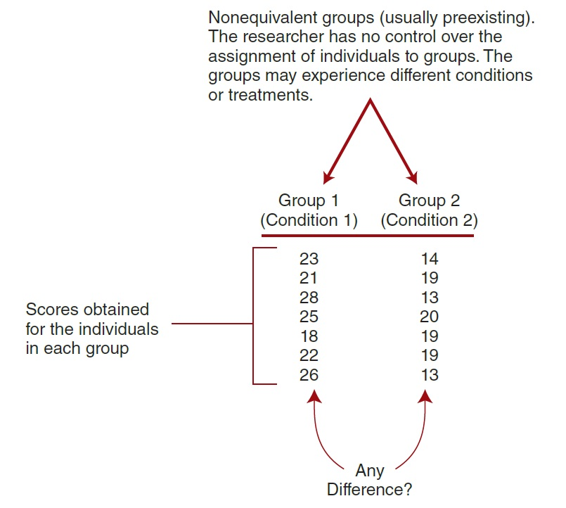
Notes:
Figure 10.3 The General Structure of a Nonequivalent Group Study

Slide 7
Threats to Internal Validity for Nonequivalent Group Designs
Note: the groups are differentiated by one specific factor that identifies the groups.
Individual differences preclude a clear cause-and-effect explanation.
  Groups have different participant characteristics.
    There is no random assignment to groups ► no assurance of equivalent groups.

Slide 8
Nonexperimental Designs with Nonequivalent Groups (1 of 2)
The differential research design: a research study that compares preexisting groups
  Goal: to establish differences between the preexisting groups
  Also called an ex post facto design—looks at differences “after the fact”

Slide 9
Nonexperimental Designs with Nonequivalent Groups (2 of 2)
The posttest-only nonequivalent control group design uses preexisting groups.
  One group serves in the treatment condition.
  A second group of similar but nonequivalent participants is used for the control condition.
  There is no random assignment to groups.

Slide 10
A Quasi-Experimental Design with Nonequivalent Groups
A pretest–posttest nonequivalent control group design compares two nonequivalent groups.
  One group is measured twice ►once before a treatment is administered and once after.
  A second group is measured at the same two times but does not receive any treatment.
  This design attempts to limit threats to internal validity—thus classified as quasi-experimental.

Slide 11
Within-Subjects Nonexperimental and Quasi-Experimental Designs
Pre-post designs: one group is measured before and after a treatment.
Threats to internal validity:
  History
  Instrumentation
  Testing effects
  Maturation

Slide 12
A Nonexperimental Pre-Post Design
The pretest–posttest design: a research study in which a series of observations is made over time for one group of participants
  There is no attempt to control the many threats that exist.

Slide 13
A Quasi-Experimental Pre-Post Design (1 of 2)
A time-series design has a series of observations for each participant before a treatment or event and a series of observations after the treatment or event.
  Value of pretest and posttest observations:
    Allow researcher to see existing trends in data
      Identify practice, fatigue, maturation, instrumentation, and regression since they should make noticeable changes before treatment
    Allow researcher to observe posttreatment trends

Slide 14
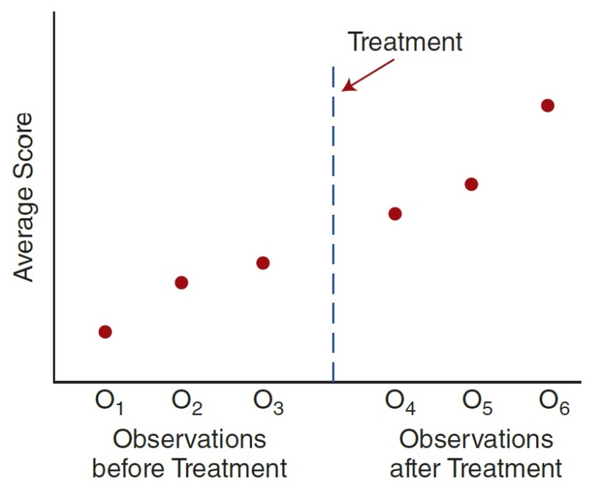
A Quasi-Experimental Pre-Post Design (2 of 2)
Possible to see the trend in the data that existed before the treatment was administered and that continues after the treatment
Notes:
Figure 10.6 A Time Series Study with Multiple Observations Before and After Treatment

Slide 15
Developmental Research Designs
Nonexperimental developmental research designs
  The cross-sectional developmental research design uses different groups of individuals.
    Each group represents a different age.
  The different groups are measured at one point in time and then compared.
  This design is an example of a between-subjects nonexperimental design (a nonequivalent group design).
  Common in developmental research

Slide 16
Strengths and Weaknesses of the Cross-Sectional Developmental Design
Strengths:
  Data can be collected in a short period of time.
    Researcher can observe how behavior changes as people age without waiting for subjects to grow older.
Weaknesses:
  Factors other than age may differentiate groups.
    Cohort effects (generation effects)

Slide 17
Strengths and Weaknesses of Longitudinal Research Designs
Longitudinal
  Strengths
    No cohort or generation effects
    Assesses individual behavioral changes
  Weaknesses
    Time-consuming
    Participant attrition may create bias
    Potential for practice effects

